Slide 1

7-Eleven

Slide 2
Agenda
Introduction
Objective
Vision/ Mission
Power BI Output
Excel Interpretation
Suggestion

Slide 3

7-Eleven, one of the world's largest store chain, is renowned for its extensive range of products and services tailored to meet the diverse needs of its customers. Founded in Dallas, Texas, in 1927, 7-Eleven has expanded to become a global retail giant with over 83,000 stores across 19 countries, including the United States, Japan, South Korea, Australia, Thailand, and China. The superstores are known for their 24/7 operations, offering an array of products such as snacks, beverages, ready-to-eat meals, fresh produce, and essential household items. With their emphasis on customer convenience and innovative offerings, 7-Eleven continues to be a leader in the convenience store especially in the US.
Introduction

Slide 4
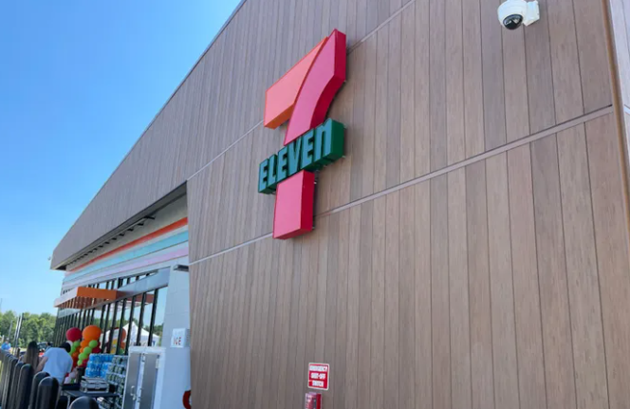
Objective
“Give the customers what they want, when and where they want it.”

Slide 5

Vision/Mission
Vision
Be the first choice for convenience. Anytime. Anywhere
Mission
We make our customers' day a little more awesome by delivering fast, personalized convenience — when, where and how they want it.

Slide 6
Power BI Output
Know your material in advance
Anticipate common questions
Maintaining composure during the Q&A session is essential for projecting confidence and authority.

Slide 7

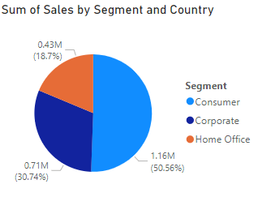
1. Sum of Sales by Segment and Country (Pie Chart)
The pie chart shows the distribution of sales across different segments within a specific country (likely the United States).
Insights:
Home Office: This segment is the largest contributor, making up 50.6% (1.16M) of total sales. This indicates a strong demand for home office products.
Corporate: The second-largest segment, contributing 30.7% (0.71M) of sales, suggests significant business from corporate clients.
Consumer: The smallest segment with 18.7% (0.43M) of sales. This might indicate potential for growth if targeted effectively.

Slide 8
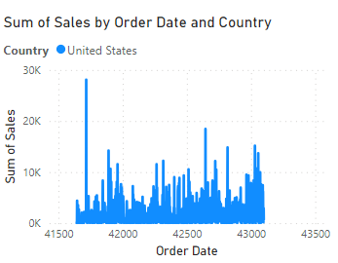
2. Sum of Sales by Order Date and Country (Line Chart):
Interpretation:
This line chart shows sales trends over time by order date within the United States.
Insights:
The chart highlights fluctuations in sales, with noticeable spikes that may correspond to key promotional periods or product launches.

Slide 9
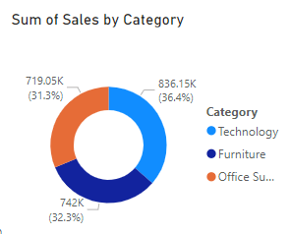
3. Sum of Sales by Category (Donut Chart):
Interpretation:
This chart displays the distribution of sales across different product categories.
Insights:
Furniture: The largest category with 36.4% (836.15K) of sales.
Technology: Close second at 31.3% (719.05K).
Office Supplies: Significant share with 32.3% (742K).

Slide 10
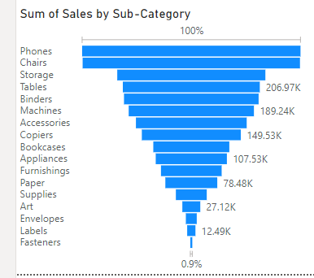
4. Sum of Sales by Sub-Category (Funnel Chart)
Interpretation:
This chart displays the distribution of sales across different product categories.
Insights:
Phones and chairs: The largest category with 100% (836.15K) of sales.
Stroage: Close second at (206.97kK).
Tables: Significant shares.

Slide 11
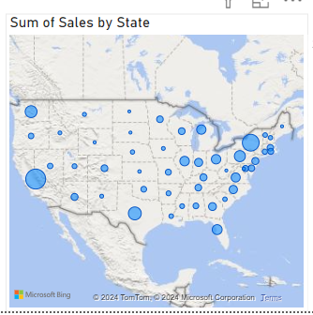
5. Sum of Sales by State (Map):
This map visualizes sales data across different states.
Insights:
High sales in certain states indicate strong market presence. States with lower sales might present opportunities for market expansion.
Recommendations:
Geographic Strategy: Concentrate marketing and sales efforts in high-performing states. Explore potential in underperforming states through localized campaigns.

Slide 12
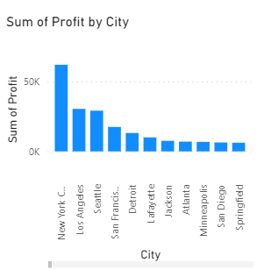
6. Sum of Profit by City (Bar Chart):
This bar chart displays the sum of profit by city.
Insights:
Top Cities: New York City, Los Angeles, and Chicago show the highest profits, suggesting successful operations in these areas.

Slide 13
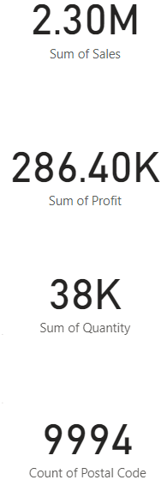
Key Performance Indicators (KPIs):
Total Sales: 2.30M indicates strong overall performance.
Total Profit: 286.40K shows a healthy profit margin, with potential for improvement.
Total Quantity Sold: 38K units reflect substantial volume.
Count of Postal Codes: 9994 unique postal codes indicate wide reach and customer diversity.

Slide 14
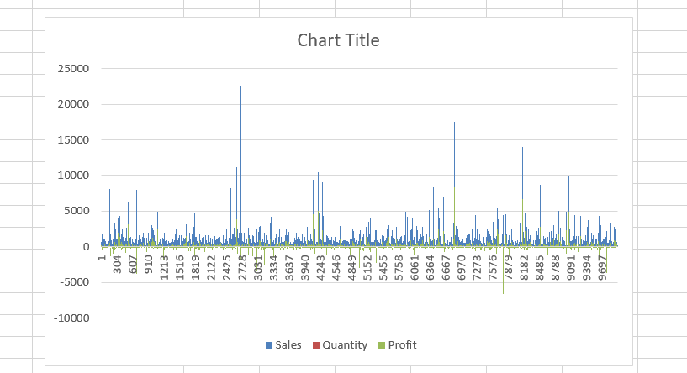
Excel file interpretation Sheet 1
we did the analysis on sales, quantity and profit to check how it is growing so we make the cluster column chart on this data and we see the positive trend line which is growing from left to right side and showing that company is doing well.

Slide 15
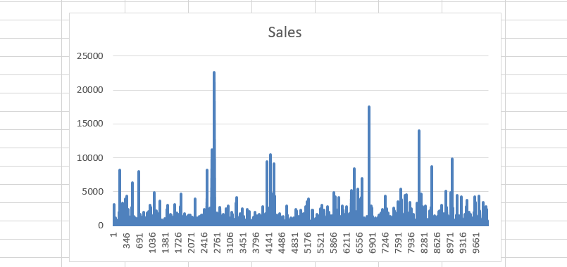
Sheet-2
The sales line chart shows that our sales are consistently increasing over time. Each point on the line represents our sales at different times, and the upward slope indicates that we're selling more and more as time goes on. This positive trend is a good sign that our business is growing.

Slide 16
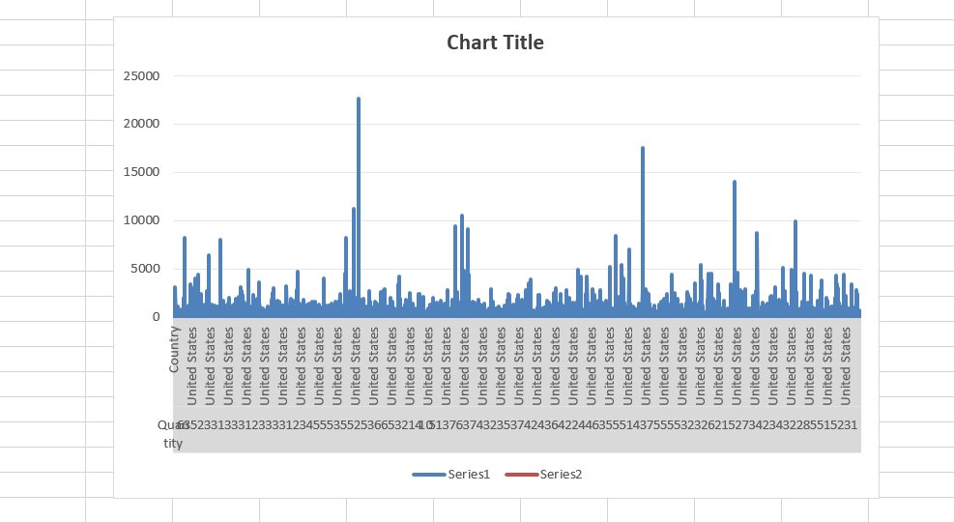
Sheet-3
The sales line chart shows that our sales are consistently increasing over time. Each point on the line represents our sales at different times, and the upward slope indicates that we're selling more and more as time goes on. This positive trend is a good sign that our business is growing.

Slide 17
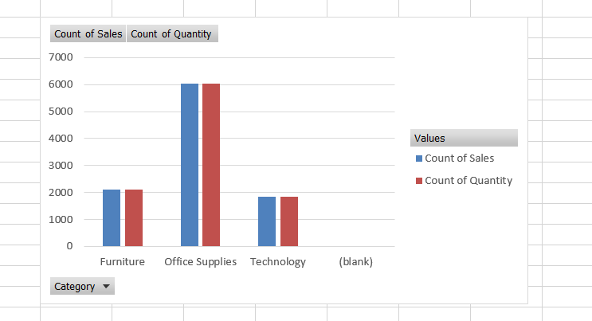
Sheet-4
we created the pivot table Shows sales and quantity for different categories (like furniture office supplies and technology) then we make the column cluster chart to check that how much sales is generated from a specific categories and on which quantity.

Slide 18
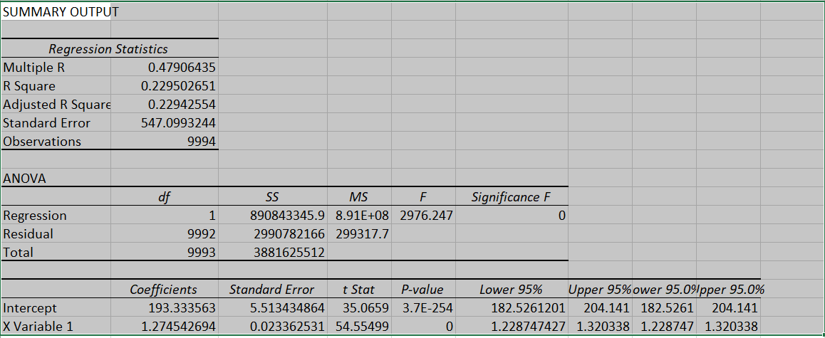
Sheet-5
The model is statistically significant.
The independent variable (X Variable 1) has a positive relationship with the dependent variable.
About 23% of the variation in the dependent variable can be explained by the model.
Both the intercept and the slope are significantly different from zero.
There is a moderate positive relationship between the two variables.
The model is good enough to show this relationship is real and not just by chance.
When the independent variable goes up by one unit, the dependent variable goes up by about 1.27 units.

Slide 19
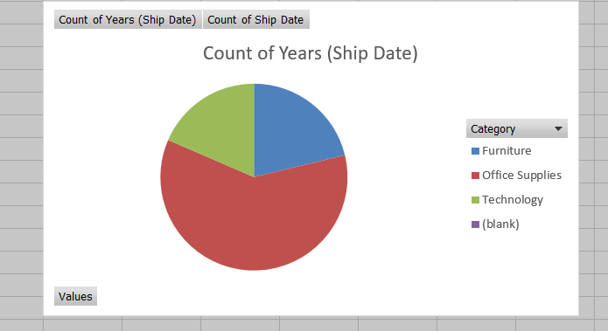
Sheet-6
Office Supplies have the highest number of ship dates (6026), making up the largest portion of the chart. Furniture is the second largest, with 2121 ship dates. Technology has the fewest ship dates among the three categories, with 1847.There is a minor count of 1 for blank entries in the years (Ship Date).
This data can help understand the distribution of shipments across different product categories, indicating that Office Supplies have the highest volume of shipments, followed by Furniture and Technology.
In this bar chart office supplies shows the highest profit and shows the positive trend.

Slide 20
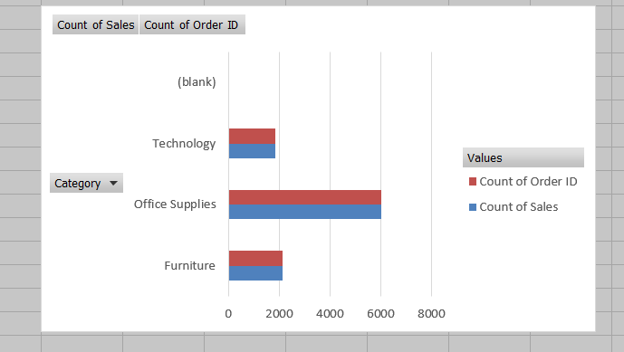
Sheet-7
Office Supplies have the highest number of sales and order IDs (6026), making up the largest portion of the bar chart. Furniture is the second largest, with 2121 sales and order IDs. Technology has the fewest sales and order IDs among the three categories, with 1847.There are no blank entries in the count of sales or order IDs.
This data can help understand the distribution of sales and order IDs across different product categories, indicating that Office Supplies have the highest volume of both sales and orders, followed by Furniture and Technology. This can be useful for inventory management, sales strategy, and resource allocation.

Slide 21
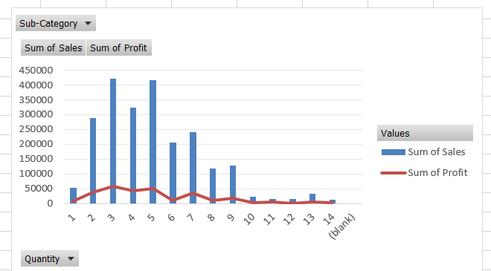
Sheet-8
The data shows sales and profits for different quantities of items.

Slide 22

Python
The notebook focuses on evaluating and comparing the performance of three different time series forecasting models: Simple Moving Average (SMA), Exponential Moving Average (EMA), and Auto Regressive Integrated Moving Average (ARIMA). The performance metric used for comparison is the Mean Squared Error (MSE).

Slide 23

1. Loading and Preprocessing Data
Although the specific code for loading and preprocessing the data is not shown in the provided notebook snippets, typically this would involve importing necessary libraries, loading the dataset, and possibly filtering or cleaning the data to prepare it for model training.

Slide 24

2. ARIMA Model
Fitting the ARIMA Model:
Calculating the MSE for ARIMA:
Output: MSE of ARIMA: 1141.2825659647353

Slide 25

3. SMA Model:
Fitting the SMA Model and Calculating Predictions:
Calculating the MSE for SMA:
Output: MSE of SMA: 4481.878508290045

Slide 26

4. EMA Model:
Fitting the EMA Model and Calculating Predictions:
Calculating the MSE for EMA:
Output: MSE of EMA: 2243.6219257674834

Slide 27

5. Comparing the Performance of All Models:
Comparing MSE Values and Determining the Best Model:
Output:
MSE of SMA: 4481.878508290045
MSE of EMA: 2243.6219257674834
MSE of ARIMA: 1141.2825659647353
Conclusion:
The ARIMA model performs best.

Slide 28

Conclusion
The detailed process involves fitting each of the models to the time series data, calculating predictions, and then comparing the mean squared error of each model. The ARIMA model showed the lowest MSE, indicating that it performs the best in terms of minimizing prediction error for the given dataset.

Slide 29

Suggested strategies
Diversify Markets: Grow in other countries to reduce reliance on the US.
Segment Growth: Focus on growing the Corporate and Home Office segments.
Balanced Product Focus: Promote all product categories while focusing on the most profitable ones.
Leverage Seasons: Use seasonal trends for better inventory and marketing planning.
These simple strategies can help 7-Eleven improve sales, profitability, and market presence.

Slide 30
THANK YOU

